Slide 1

The Big Picture
Python Unit
Python
Pandas
Matplotlib
APIs
Unit Assessment
Visualization Unit
Web Scraping
Plotly
Leaflet
Tableau
Unit Assessment
Final Project
Project Design
Train Model & Build Database
Dashboards Presentation
01
03
05
02
04
06
Excel Unit
Excel
VBA
Unit Assessment
Databases Unit
SQL
ETL
SQLite
Unit Assessment
Advanced Topics Unit
R—Stats
Big Data—AWS
Machine Learning
Unit Assessment

Slide 2
Boot Camp Pointers
As you work through this module, remember the following:
01
02
03
Your Bootcamp Spot material is connected to the things we will do during class.
It’s all part of the journey!
Your coursework this week will prepare you with all the skills that you need to succeed on your Challenge assignment!
Be proactive in using Office Hours to get help with any installation issues.
We’re here to help!

Slide 3
This Week: Excel
Module 1

Slide 4
This Week: Excel
By the end of this week, you’ll know how to:
Import data into Excel
Apply filters, conditional formatting, and formulas to data
Create and interpret charts and pivot tables in Excel
Calculate summary statistics
Characterize data to identify outliers in datasets
Visualize the distribution of data using box plots

Slide 5

This Week’s Challenge
Using pivot tables and functions to filter data, create charts that demonstrate an analysis of data sets to visualize business outcomes based on launch dates and goals.

Slide 6

Career Connection
How will you use this module’s content in your career?

Slide 7
How to Succeed This Week
Module 1

Slide 8
Quick Tip for Success:
There are hundreds of Excel functions. You’ll have to look some of them up. Consider this your first opportunity to dive into some documentation!

Slide 9
Today’s Agenda
Module 1

Slide 10
Today’s Agenda
By completing today’s activities, you’ll learn the following skills:
01
Calculating Averages
02
Pivot Tables & Pivot Charts
03
VLOOKUP() & HLOOKUP()
Make sure you’ve downloaded any relevant class files!

Slide 11
Activity: Gradebook
Create a formula that calculates the final grade for a student based on their previous exams and papers.
15 minutes

Slide 12
Activity: Gradebook
Suggested Time: 15 minutes
To do: | When making this calculation: | Bonus:
Create a formula that calculates the final grade for a student based upon their previous exams and assignments. | Consider every assignment and exam to be equal in weight; each should comprise one-fourth of the overall grade. Round the result to the nearest integer. Using conditionals, create a formula that returns PASS if a student’s final grade is greater than or equal to 60. If a student’s final grade is below 60, the formula should return FAIL. | Create a nested IF() formula that returns a letter grade based on a student’s final grade. Greater than or equal to 90 = A Greater than or equal to 80 and less than 90 = B Greater than or equal to 70 and less than 80 = C Greater than or equal to 60 and less than 70 = D Anything less than 60 = F

Slide 14
Pivot Tables

Slide 15
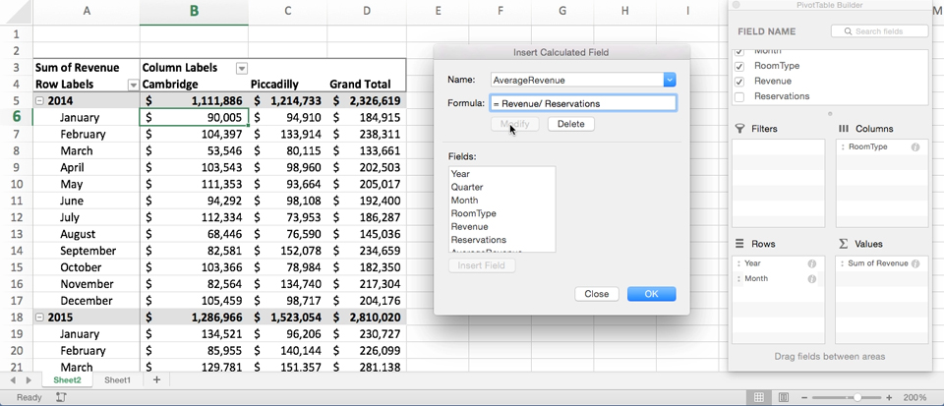
Get Pivot With It
Pivot tables are one of the most important data visualisation concepts to master in this class (don’t worry, they are a cinch to deal with).
Notes:
Explain that another powerful tool in the Excel arsenal is Pivot Tables, which allows users to extract summary data from large, detailed, consistent, and data sets.

Slide 16
Get Pivot With It
Essentially, a pivot table is a summative analytic tool that allows us to perform aggregate functions that allow any combination of fields. The term pivot table comes from the fact that we are pivoting along a data axis.
Seller | Quantity Sold | Date
Joseph | $42.50 | 1/1/17
Jacob | $65.00 | 1/3/17
Jacob | $5.25 | 1/6/17
Joseph | $125.00 | 1/6/17
Jacob | $3.50 | 1/7/17
Matt | $32.00 | 1/9/17
Seller | Total Sold
Joseph | $167.50
Jacob | $73.75
Matt | $32.00
Notes:
Explain that pivot tables summarize data using functions like SUM, COUNT and AVERAGE on subsets of the data. These subsets can be as general or as specific as we like.

Slide 17

Word to the Wise: Keep It Flat!
Modern business intelligence (BI) tools like Tableau, Sisense, and Salesforce work best if data is stored in flat CSVs—meaning column headers represent fields (vertically) on the spreadsheet. This is largely because all of these technologies heavily utilise pivot tables as a tool for their visualisations. Don’t try to confuse this simplicity. “Spreadsheet magic” is a nightmare to analyze.
Notes:
Caution students that pivot tables are not designed for deeper analysis, they are designed to provide at-a-glance summary metrics.

Slide 18
<Time for Excel>

Slide 19
Activity: Top Songs Pivot Table
In this activity, you will use a 5000-row spreadsheet containing data on the top 5000 songs from 1901 on. Using pivot tables, you will uncover which artists have the most songs in the top 5000, what the songs are, and what year they were released.
15 minutes

Slide 20
Top Songs Pivot Table Instructions
Select all of the data in your worksheet and create a new pivot table.
Make a pivot table that can be filtered by year and contains two rows: Artist and Name.
All of an artist’s songs should be listed below their name.
Update your pivot table to contain values for:
How many songs an artist has in the top 5000
The sum of the final_score of their songs.
Sort your pivot table by descending sum of the final_score.
Suggested Time: 15 minutes

Slide 22
Lookups

Slide 23

Look It Up with Lookups
Q
Assume this table is gigantic. How would we retrieve the population of a specific planet for use in another formula?
Planet | Population
Zeelo | 5020
Merinoa | 380
Cardboard Box | 2
… | …
Asteroid 9 | 95
Notes:
Explain that we have already looked at how to summarize large data sets, but what if we needed to retrieve specific values from a data set?
Explain that when working with large workbooks which contain multiple tables, it sometimes becomes very challenging to find specific values.

Slide 24

Look It Up with Lookups
Q
Assume this table is gigantic. How would we retrieve the population of a specific planet for use in another formula?
A
=vlookup( <value>, <full table>,
<column to retrieve>,<match parameter>)
Planet | Population
Zeelo | 5020
Merinoa | 380
Cardboard Box | 2
… | …
Asteroid 9 | 95
Notes:
Explain that lookup functions in Excel are designed to search through ranges and create references automatically.

Slide 25
Look It Up with Lookups
Q
What will this yield?
=vlookup( “Asteroid 9”, Planets, 3, FALSE)
Planet | Population | Species
Zeelo | 5020 | Zoltans
Merinoa | 380 | Murphies
Cardboard Box | 2 | Hambones
… | …
Asteroid 9 | 95 | Asterisks
Notes:
Point out that there are two lookup functions: vlookup and hlookup.

Slide 26
Look It Up with Lookups
Q
What will this yield?
=vlookup( “Asteroid 9”, Planets, 3, FALSE)
Planet | Population | Species
Zeelo | 5020 | Zoltans
Merinoa | 380 | Murphies
Cardboard Box | 2 | Hambones
… | …
Asteroid 9 | 95 | Asterisks
A
Asterisks
Notes:
Explain that vlookup is used to find values in adjacent columns, while hlookup is used to find values in adjacent rows.
Explain that lookup formulas work by:
Selecting a range of data to browse through (generally a table)
Selecting a value from within that range
Selecting what corresponding information is desired
Grabbing the result

Slide 27
<Time for Excel>

Slide 28
Activity: Product Pivot
A small company selling electronics and electronic media has asked our class to create a table that visualizes the cost of their recent orders. Using lookups, create a pivot table that serves this purpose.
15 minutes

Slide 29
Activity: Product Pivot
Suggested Time: 15 minutes
Determine the “Product Price” of each row in the “Orders” sheet by using a VLOOKUP() that references each row's “Product ID.”
Determine the “Shipping Price” of each row in the “Orders” sheet by using a VLOOKUP() that references each row's “Shipping Priority.”
Select all of the data on the “Orders” sheet and create a new pivot table that calculates the sum of both “Product Price” and “Shipping Price” for each “Order Number” and “Product ID.”
The “Product Price” of a row does not include shipping.

